Slide 1
Hydrological Information System
Module - Discharge Measurement
Anish
….. Hydro-Informatics Expert
The World Bank

Slide 2
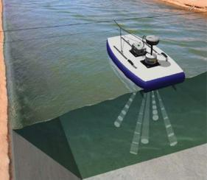
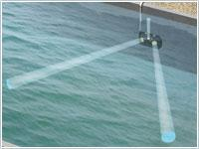
Acoustic Doppler Systems
Concept
  Acoustic Doppler systems rely on SONAR which uses sound waves to determine the distance to targets
  The Doppler Effect is used to resolve the velocity of flowing water by bouncing acoustic signals of a known frequency off backscatterers or targets in the water column and measuring the change in frequency of the return signal.
  Targets are generally sediment or organic materials in the water column that are moving at the same velocity and direction as the water.
Types
  Fixed
  Current Profilers

Slide 3
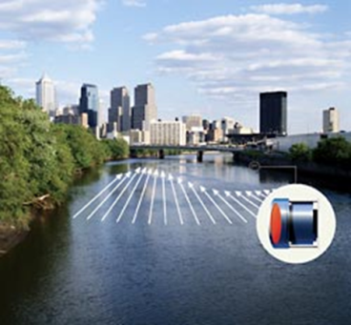
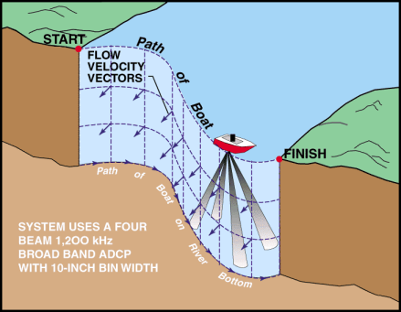
Acoustic Doppler Current Profilers (ADCP)
Acoustic Doppler Velocity Meters (ADVM)

Slide 4
ADVM - General Information
Well-suited for discharge measurements in canals with fixed channel geometry
Effective for monitoring discharge in tidally affected rivers or other unsteady flow reaches
ADVM’s can be a good alternative for streams where constant silting causes inaccuracy when using the traditional stage-discharge method.
Useful for acquiring detailed velocity data for model calibration.

Slide 5
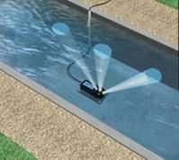
Upward Looking ADVM
ADVM is mounted to the bottom of the channel.
Channel shape is input into data logger for calculation of discharge.
Ideal Locations
  Canals where the water is generally free from sediment and debris
  Pipes or culverts flowing full or partially full

Slide 6
Side Looking ADVM
ADVM is mounted on or near one of the banks of a channel.
Velocity is calculated along beam paths and converted to average channel velocity using an “Index-Velocity” rating.
The cross-sectional geometry is surveyed and used to calculate discharge.
Ideal Location
  Typically deployed in an natural channel
    Reduces the chance for sediment covering the sensor
    Sensor mounted out of the way of highest velocities and potentially damaging debris

Slide 7
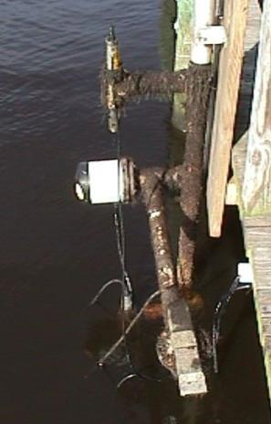
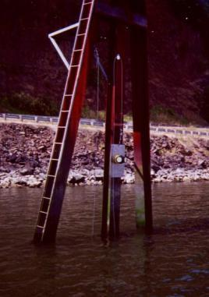
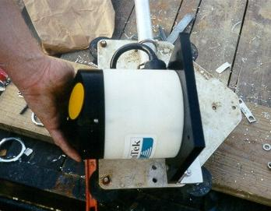
SonTek Argonaut SL
Notes:
Here are photos of the most common horizontal profiler – the SonTek Argonaut SL. The photo on the right shows a SonTek ADP SL at a gauge on the Columbia River in Oregon.

Slide 8
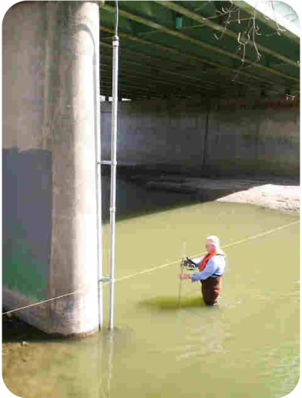
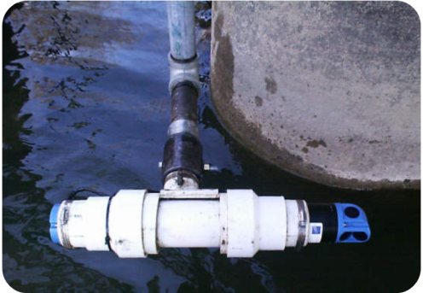
Nortek EZ-Q
Notes:
This is a Nortek EZ-Q mounted to a bridge pier in Indiana. It was mounted to the pier ‘facing’ towards the left bank. Do you notice anything odd or wrong about the discharge measurement being made in the photo on the right?
The streamgager is standing in the area that includes the sampling volume for the horizontal profiler.

Slide 9
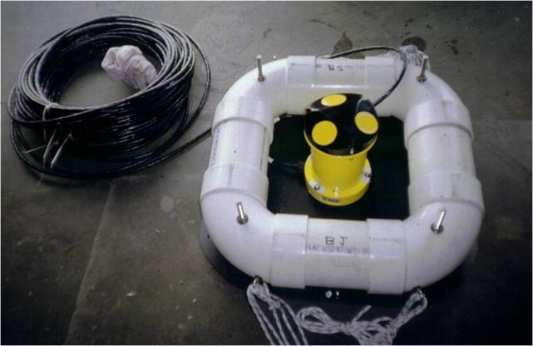
Sontek Uplooker ADP
Notes:
This is a photo of a SonTek ADP uplooker that was used for some work in Florida. The ADP was direct-cabled to shore.

Slide 10
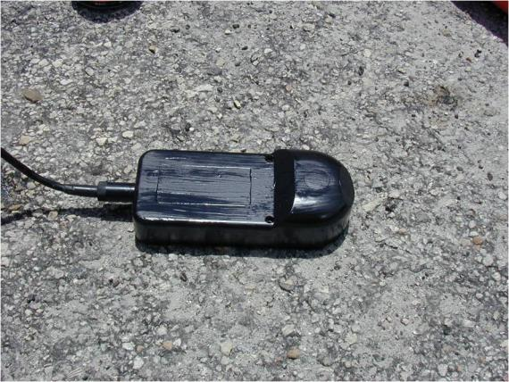
Sontek Argonaut SW
Notes:
Here is one of the newer profilers, the SonTek Argonaut SW. This profiler was originally designed for use in shallow canals and can be used to directly measure the flow. It is being used in several offices in the USGS as an index-velocity meter.

Slide 11
ADCP (Current Profiler)
Used for making instantaneous discharge measurements in lieu of standard mechanical meters using cups or propellers
Usually attached to a motorized boat or towed flotation device

Slide 12
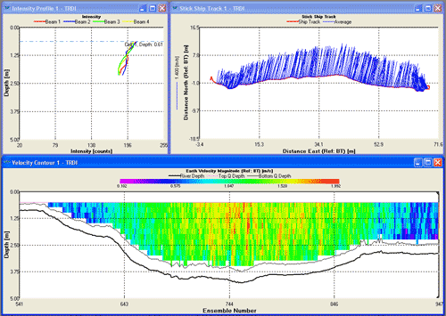
ADCP Discharge Measurement
Computes discharge on-the-fly
Provides complete velocity structure and channel geometry for model input

Slide 13
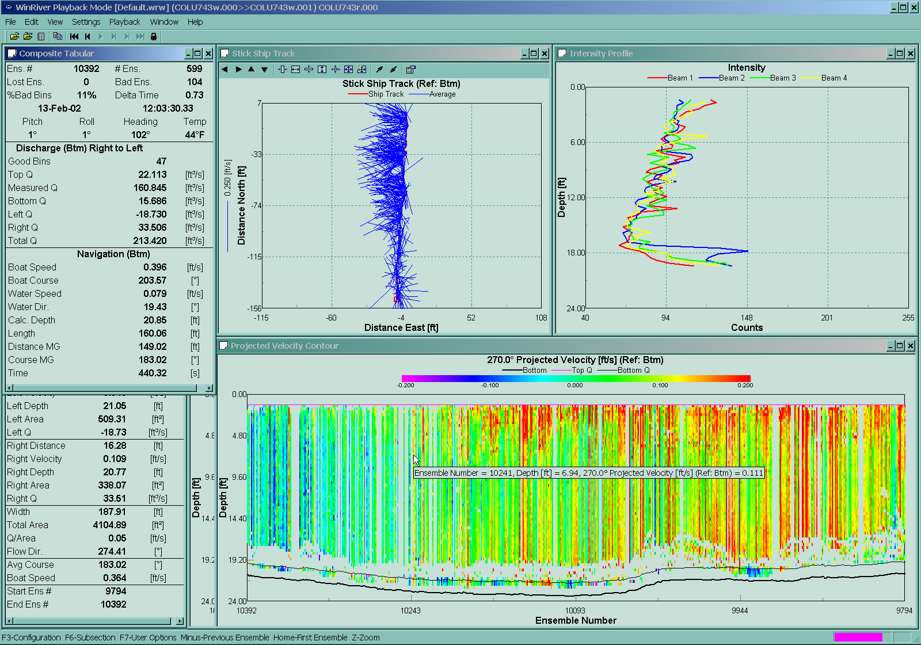
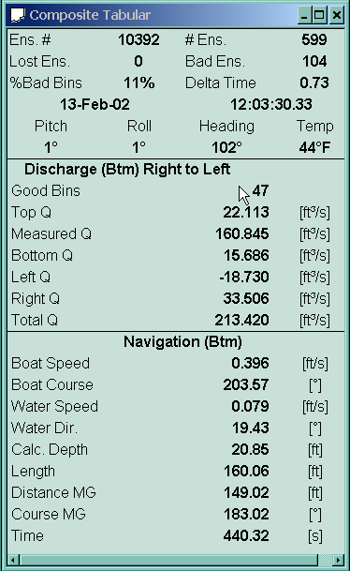
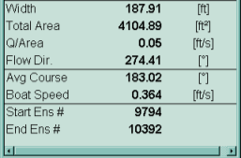
Low Flow Measurements
Mean Velocity = 0.05 ft/s
Notes:
This slide illustrates a discharge measurement of a very low flow – where the mean velocity was 0.05 ft/s ( xx cm/s ). This measurement was made in the Chicago River, where the cross sectional area is in excess of 4,000 square feet.

Slide 14
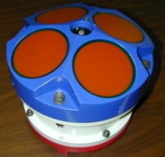
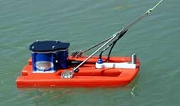
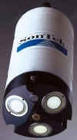
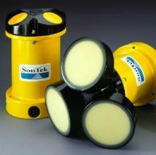
Some Commonly Used ADCPs
RDI StreamPro
RDI Rio Grande ADCP
SonTek Mini-ADP
SonTek ADP
Notes:
Here are some of the commonly used ADCP’s. One ADCP not shown is the Boogiedopp ADCP. The future of the Boogiedopp is somewhat ‘up in the air’ at present, although there are approximately 10 in use in the USGS.

Slide 15
Other Applications for Acoustics
Sediment monitoring
Bathymetric mapping

Slide 16
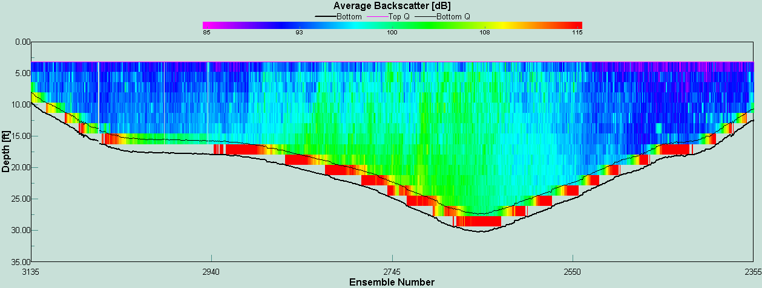
Using Acoustic Backscatter as a Surrogate of Sediment Concentration
Notes:
Another example of use of uplookers is from New York where an uplooker is being used to estimate suspended sediment loads on the Hudson River. Shown here is a backscatter contour plot from WinRiver. The question is, Can we use acoustic backscatter (ABS) as a surrogate for suspended sediment concentration? When one studies backscatter contour plots such as this one, it seems possible, at least qualitatively.

Slide 17
Acoustic Doppler Systems: Advantages/Disadvantages
Advantages
  Measures discharge in a wide variety of unsteady flow situations and where no stage-discharge relation exists
  Ideally suited for estuaries and canals
  Instantaneous Discharge
  Saves time over conventional measurements saving time and improving safety
  Potential application in sediment monitoring and bathymetric surveys
Disadvantages
  Complexity (requires significant and ongoing training)
  Costs are high but coming down

Slide 18
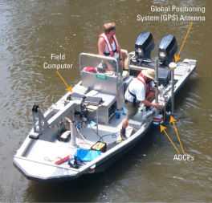
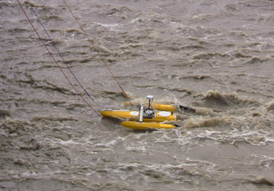
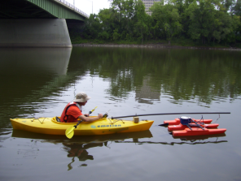
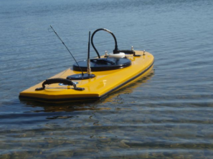
ADCP Deployment Methods
Motorboat
Tethered boat
Kayak (paddle boat)
Remote controlled boat

Slide 19
ADCP Deployment
Tethered Boats
Tethered from Manned Boats
Cableways
Remote control Boats
Vehicle Mounted Crane

Slide 20
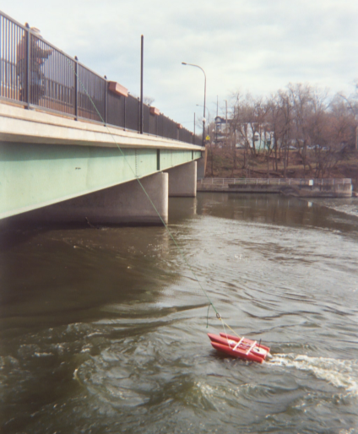
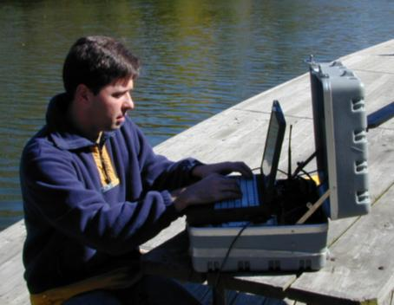
Streamflow Measurement – Tethered Boats
Notes:
This slide shows a tethered boat being used to make a discharge measurement. With tethered boats, ADCP data is radioed from the ADCP on the boat to the ADCP operator who is located somewhere on the shore (see photo on the left). Tethered boats measurements require 2 people, one to operate, configure, and collect data from the ADCP, and the other to operate the boat by means of a tether. This person can set up anywhere as long as he/she is within range of the radio modems. The other person tows the tethered boat back and forth across the measurement section (photo on the right).
What potential problems do you observe in the measurement being made on the right?

Slide 21
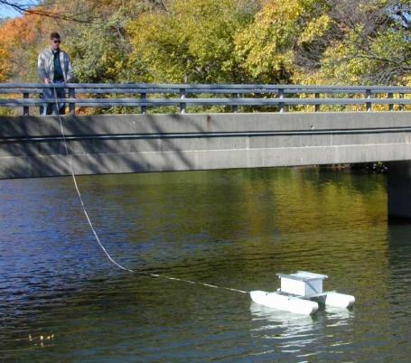
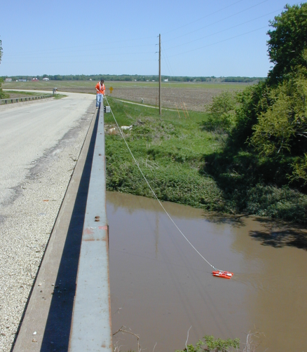
Bridge Measurements
Notes:
Most common method is from the downstream side of a bridge. What problems might you encounter on the downstream side of bridges? Turbulence from bridge piers, still might have traffic safety issues.

Slide 22
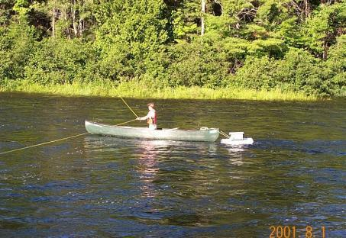
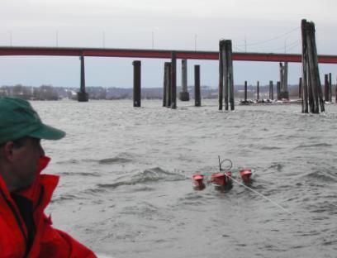
Tethered from a Manned Boat
Notes:
Gets ADCP away from biases and other problems caused by the manned boat (metal/compass problems, flow disturbance/boat wake problems, dampens effects of “jerky” boat pilot, less pitch and roll than on manned boat when in still water)
Potential problems…
On large rivers where there is a lot of “chop” a large stable manned boat may have less pitch/roll than a small tethered boat.
Be aware of any possible flow disturbances caused by the manned boat near the tethered boat.
Depending on the method of deployment, it may harder to control boat that are tethered to manned boats.

Slide 23
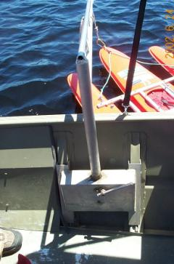
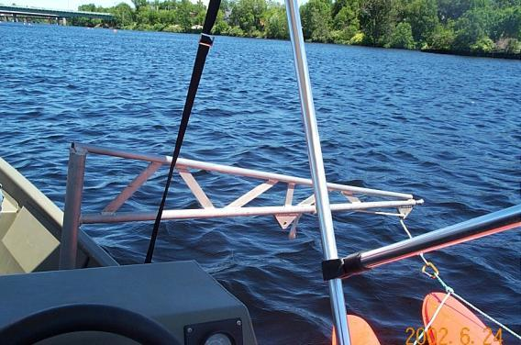
Boat Mounted
Tethered Platform Deployments
Notes:
Boom mount to use tethered boat from a manned boat.
The boom moves the tethered boat away from flow disturbance of the manned boat and also isolated tethered boat from the pitch and roll of the manned boat. Because the tethered boat tends to always have the same payload, changes in transducer draft are much less of a concern.

Slide 24
Tethered Boat Measurements
Advantages:
  Less time on bridges compared to conventional bridge measurements , reducing exposure to traffic hazards
  Fast and easy deployment
  Can often be used where manned boats cannot be launched
  Can move more slowly across the river with more control than a manned boat, depending on site conditions
Notes:
Advantages:
Generally safer than using manned boats
Can be deployed easier and faster than manned boats
Can often be used where manned boats cannot be launched
Can be moved across the river more slowly and with more control than a manned boat; improving ADCP measurement quality at some sites.
Advantages of using tethered boats for ADCP measurements:
When compared to convention price AA bridge measurements, tethered boat ADCP measurements made from bridges require less time spent on bridges. This reduces the time people are exposed to traffic hazards.
Tethered boats can be quickly deployed from bridges without long setup time.
For sites where there is not a boat ramp for launching manned boats, tethered boats can be lowered from bridges, or used from cableways.
In many situations, especially in smaller streams, it can be easier to make a more controlled measurement when using a tethered boat compared to a large manned boat.

Slide 25
Tethered Boat Measurements
Limitations:
  Generally confined to the downstream side, with limited ability to change measurement sections by changing rope length
  Turbulence from bridge piers and abutments can degrade measurement quality
Notes:
Limitations:
Measurement site selection is limited- usually confined to the downstream side of bridges and from cableways
The quality of measurements made on the downstream side of bridges can be degraded by turbulence from bridge piers
Very difficult to use GPS/depth sounder from a tethered platform when needed for moving bed conditions
Limitations of tethered boat measurements:
Measurement-site selection is limited. Use of a thetered boat usually is confined to the downstream side of bridges and to cableways. The ablity to change measurement sections from these structures is limited to changes in rope length to vary the doantream distance of the boat.
The quality of discharge measurement made on the downtream side of bridges can be degraded by turbulence from bridge piers and abutments.
If GPS and/or depth sounder are require they each require another set of radio modems or special multi-channel radio modems.

Slide 26
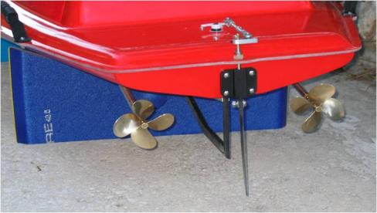
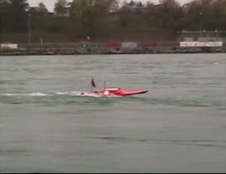
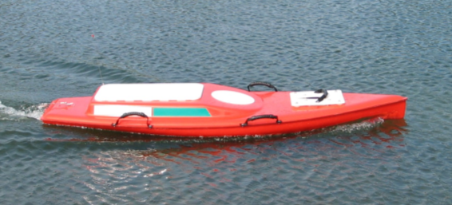
Streamflow Measurement –
Remote Control Boats
Notes:
In addition to using manned and tethered boats for ADCP measurements, the USGS has invested into the development of remote-controlled (RC) boats. This remote control boat can be used where use of a manned boat is difficult or unsafe, such as insufficient clearance under bridges. It could be that in the future, as we perfect the development of RC boats and their control systems, many of our measurements will be made with RC boats. This particular boat was built under contract with OceanSciences Group. The video clip in the upper right shows an earlier prototype of this RC boat.

Slide 27
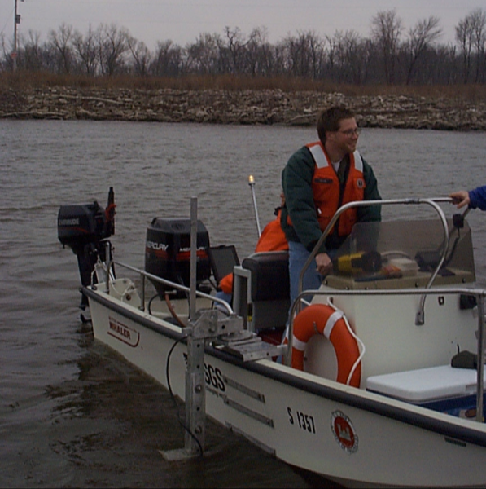
Streamflow Measurement – Manned boat
Notes:
This slide shows the use of a manned boat to make an ADCP measurement. Notice that this boat is equipped with a kicker motor in addition to the main motor for the boat.

Slide 28
Vehicle Mounted Crane
Experience from Goa
-By Mr. Ghanti

Slide 29
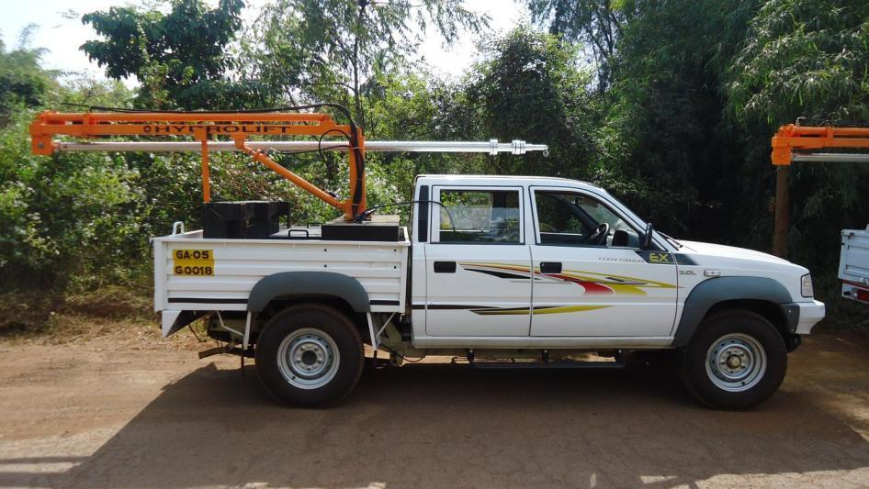

Slide 30
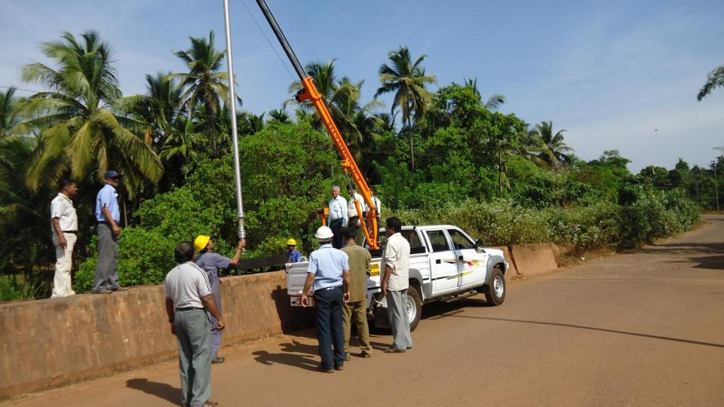

Slide 31
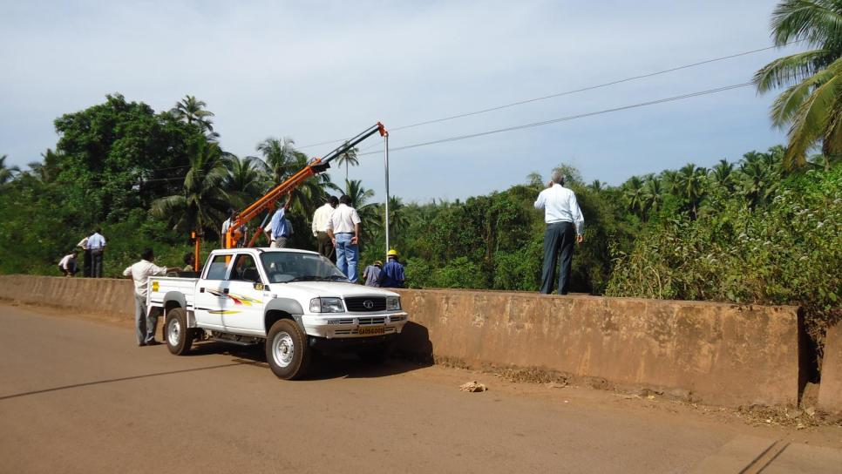

Slide 32
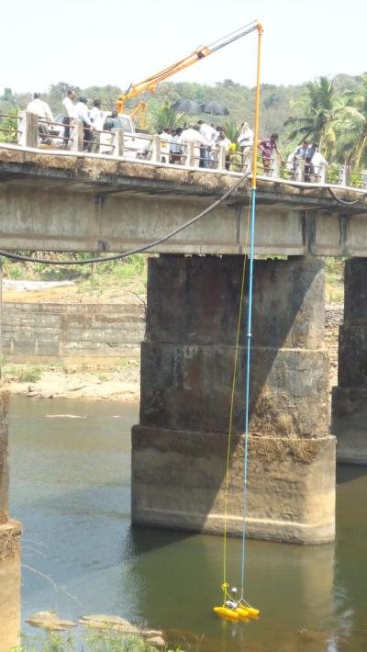
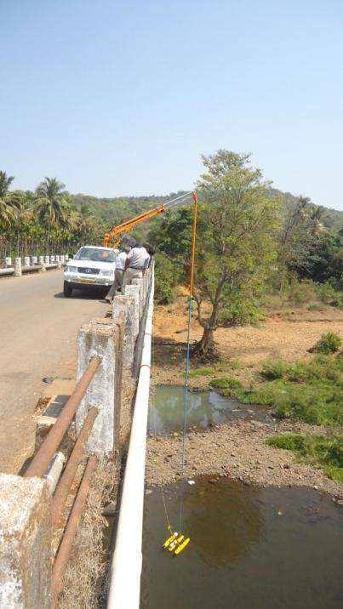

Slide 33
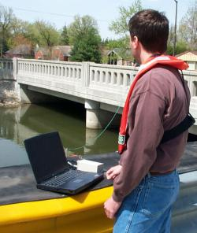
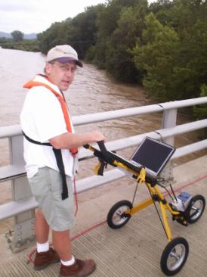
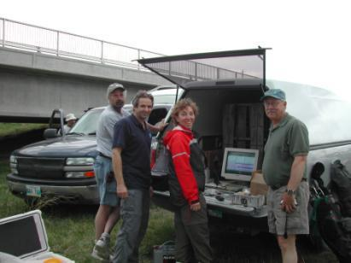
Computer
Operator
Notes:
Usually the Computer operator sits on the shore while another person pulls the boat back and forth across the stream.
Some people have made one man tethered ADCP measurement by taking the laptop with them while pulling the tethered boat across the river.
Picture on left shows laptop attached to a golf cart, with battery and radio modem.
Picture on top right shows normal bank setup.
Picture on bottom right shows the Canadians using a full size CRT monitor in the back of the truck.

Slide 34
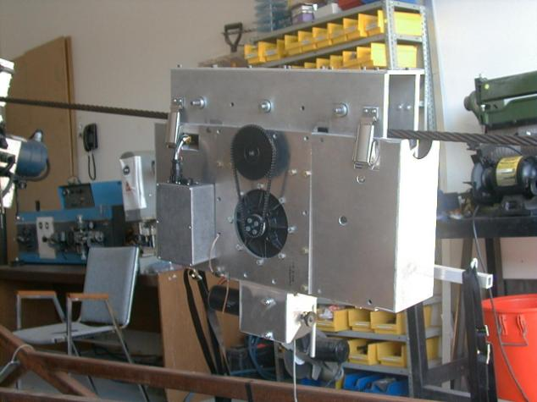
Cableway Measurements
Notes:
Canadian remote control cable way.

Slide 35
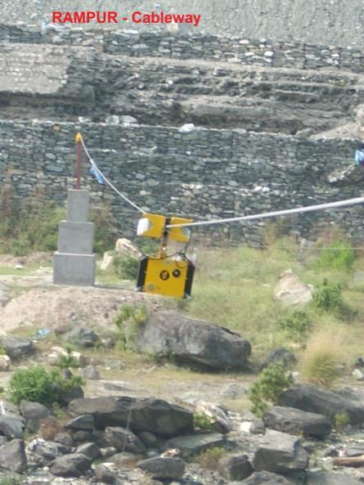
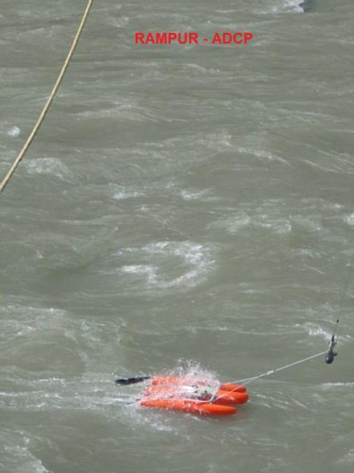
Cableway - BBMB

Slide 36
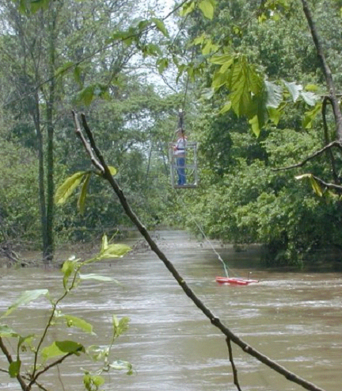
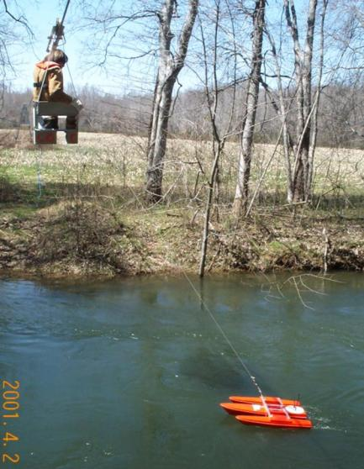
Cableway Measurements

Slide 37
Site Selection
Close attention should be paid to ensuring the measurement is being made at a suitable site.
If parts of the cross section are of unacceptable quality, the length of the tether may be adjusted in an attempt to find a more suitable cross section slightly farther up or downstream.
At some sites, it may not be possible to use a tethered platform to make an ADCP measurement because of the limited ability to change the measurement cross-section location.

Slide 38

Site Problems
Notes:
This is an example of a fairly good bridge measurement site. Ask what might some problems be at this site? Assuming this is the down stream side of the bridge, at the right edge weeds/tall grass can be seen coming out of the water, so depth may be a problem. Also, if there are lots of submerged vegetation, you may have a bottom tracking problem.

Slide 39

Site Problems
Complex currents, turbulence, and reverse flows around bridges can result in a poor measurement section
Bridges with truss structures make it difficult to tow a boat across the channel.
Notes:
Lots of turbulence downstream of piers. The left edge actually has reverse flow. Truss bridge makes it very difficult to tow the boat across the channel.

Slide 40

Site Problems
Notes:
Lots of turbulence downstream of piers. The left edge actually has reverse flow. Truss bridge makes it very difficult to tow the boat across the channel.

Slide 41
Instrument Considerations

Slide 42
Accuracy and Precision
  Sensor accuracy
  Resolution
  Range
  Drift
  Clock accuracy
  Response time
  QA testing (trust but verify)

Slide 43
Technical
  Power requirements
  Input/Output connections
    Type
    Number
  Memory protection
  Surge protection
  Data storage capacity
  Data handling (fill and stop or write over)
  Software and firmware
  Programming interface (display, PC, tablet)

Slide 44
Environmental
  Operating range for temperature and humidity
  Thermal and mechanical shock (transportation, storage, and deployment)
  Vibration
  Solar radiation
  Wind
  Sand and dust
  Ice
  Corrosion
  Build quality (internal and external)
  Regulatory compliance (frequency, signal strength, FCC approval)

Slide 45
Operational
  Maintenance requirements
  Complexity
    Installation
    Programming
    Calibration
  Expandability

Slide 46
Procurement
  Specifications
    Too few can result in unacceptable products
    Too many can cost more and miss a good solution.
  Warranty
  Vendor support (technical and warranty)
  Cost

Slide 47
Cost Table (Approximate)
Item | Cost (INR)
Shaft Encoder | 60,000
Bubbler | 180,000
Pressure Transducer | 60,000
ADCP | 1,200,000
ADVM | 300,000
Ultrasonic Sensor | 90,000
Radar Sensor | 180,000
Data Logger | 120,000

Slide 48
Questions/Comments?

